Slide 1
WEB CONTENT SUMMARIZATION & ACCESSIBILITY WITH VOICE OUTPUT
TEAM MEMBERS
SANJANA SANGA
SUHAS PANUGANTI
RISHIKESH REDDY MAMILLA

Slide 2
TABLE OF CONTENTS
ABSTRACT
INTRODUCTION
CORE IDEA
WORK PLAN
ARCHITECTURE
SYSTEM DESIGN
RESULTS
CONCLUSION

Slide 3
ABSTRACT
Visually impaired users struggle to navigate modern websites that are cluttered with advertisements, multimedia, and dynamically loaded content. Traditional screen readers read every element sequentially, including irrelevant sections, which overwhelms users and makes it difficult to identify the main information they need. This results in information overload, slower comprehension, and frustration during even simple browsing tasks. As websites continue to evolve with complex layouts and interactive features, existing accessibility tools fail to provide clarity, efficiency, or continuity across sessions. The gap between rapidly advancing web technologies and outdated accessibility methods highlights the urgent need for more adaptive and user-friendly solutions that truly meet the needs of visually impaired users.

Slide 4
INTRODUCTION
The core idea is to develop a browser-based system that transforms how visually impaired users interact with the web by combining real-time content extraction, AI-powered summarization, and natural voice output. Instead of reading entire pages sequentially like traditional screen readers, the system will focus on extracting meaningful sections of a webpage, generating concise summaries, and delivering them through text-to-speech for a smoother experience. By maintaining context across browsing sessions and logging interactions for research, the solution aims to provide an accessible, efficient, and user-friendly way to consume online information in today’s increasingly dynamic and cluttered web environment.

Slide 5
Motivation
• Traditional screen readers read everything including ads, menus, and clutter.
• Users get overwhelmed, especially visually impaired users.
• Many product websites use text inside images.
• Our solution: AI-powered intelligent reading and navigation.

Slide 6
Core Idea
• Extract meaningful webpage content
• Filter ads and noise
• Summarize using NLP
• Speak summaries using TTS
• Voice-based navigation and OCR for complex sites

Slide 7
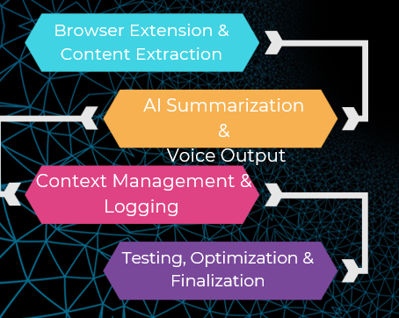
WORK PLAN

Slide 8
Version 1 – Foundation
DOM extraction & content segmentation
Ad/promo filtering
NLP summarization (OpenAI)
Hover-to-read preview
Page summary (P key)
Priority tagging (1/2/3 keys)
Text-to-speech integration

Slide 9
Version 2 – Enhancements
Voice recognition (V key)
Fuzzy semantic search for queries
Button/link/input recognition (reads label only)
OCR integration for shopping sites
Faster summarization with caching
Stronger matching logic

Slide 10

Architecture Overview
NLP Layer
(Summarization + Ranking)
Content Capture Layer
(DOM + OCR)
Voice Interaction Layer
(Speech Recognition + Fuzzy Search)
Output Layer
(Overlay UI + TTS)
Browser Extension Shell
(Manifest V3)

Slide 11

System Workflow
1. Extract webpage text → clean noise
2. Summarize paragraph or section
3. Display overlay preview
4. Speak via TTS
5. User interacts via:
• Hover
• Keyboard shortcuts
• Voice commands
6. OCR enriches text when required

Slide 12
OCR Integration
Shopping/product sites use image-based text
OCR (Tesseract.js) extracts text from images
Merged with DOM text → summarized → spoken
Improves accuracy for Amazon-like sites

Slide 13

Voice Navigation
Press V to activate voice recognition
NLP + fuzzy matching improves section detection
System scrolls to best matching section and reads aloud
Handles queries like:
'early life', 'spouse details', 'cheapest option'

Slide 14
Version Comparison
Version 1:
Summarization
Hover reading
TTS
Version 2:
Voice commands
OCR
Advanced matching
Interactive element handling
Improved speed and accuracy

Slide 15
Results
80% accurate content segmentation
70–90% summarization quality
95% accurate button/control detection
OCR boosts performance on product tiles
Voice navigation works reliably

Slide 16
Conclusion
AI Smart Reader merges NLP, OCR, browser scripting, and accessibility design.
Version 1 created the foundation; Version 2 added intelligence and interaction.
Future Work:
Multilingual support
Offline LLM
Full screen reader replacement

